Slide 1
Accounting Information Systems
PRESENTED BY: EDGAR OTIENO
Lecture 7
Ethics Fraud & Internal Control and Auditing computerized financial systems
Notes:
2

Slide 2
Ethics Fraud & Internal Control Objectives
Broad issues pertaining to business ethics
Ethical issues related to the use of information technology
Distinguish between management fraud and employee fraud
Common types of fraud schemes
Objects and application of physical controls
Notes:
3

Slide 3
Business Ethics
Why should we be concerned about ethics in the business world?
Ethics are needed when conflicts arise—the need to choose
In business, conflicts may arise between:
  employees
  management
  stakeholders
Litigation
Notes:
8

Slide 4
Business Ethics, cont ….
Business ethics involves finding the answers to two questions:
How do managers decide on what is right in conducting their business?
Once managers have recognized what is right, how do they achieve it?

Slide 5
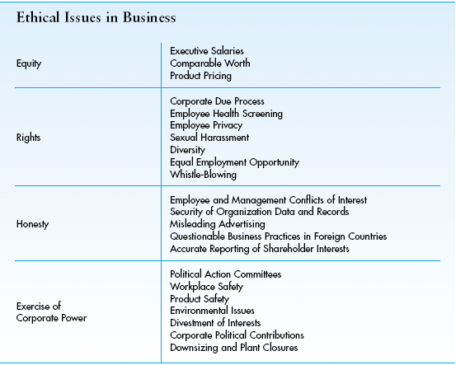
Four Main Areas of Business Ethics
Notes:
8

Slide 6
Computer Ethics
Concerns the social impact of computer technology (hardware, software, and telecommunications).
What are the main computer ethics issues?
  Privacy
  Security—accuracy and confidentiality
  Ownership of property
  Equity in access
  Environmental issues
  Artificial intelligence
  Unemployment and displacement
  Misuse of computer
Notes:
8

Slide 7
Legal Definition of Fraud
False representation - false statement or disclosure
Material fact - a fact must be substantial in inducing someone to act
Intent to deceive must exist
The misrepresentation must have resulted in justifiable reliance upon information, which caused someone to act
The misrepresentation must have caused injury or loss
Notes:
9

Slide 8
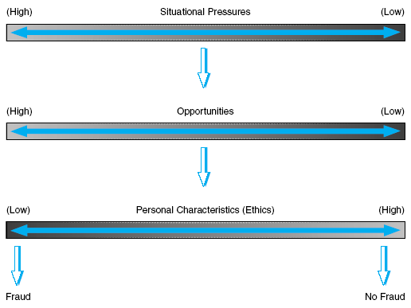
Factors that Contribute to Fraud

Slide 9
Employee Fraud
Committed by non-management personnel
Usually consists of: an employee taking cash or other assets for personal gain by circumventing a company’s system of internal controls
Notes:
10

Slide 10
Management Fraud
Perpetrated at levels of management above the one to which internal control structure relates
Frequently involves using financial statements to create an illusion that an entity is more healthy and prosperous than it actually is
Involves misappropriation of assets, it frequently is shrouded in a maze of complex business transactions
Notes:
12

Slide 11
Fraud Schemes
Three categories of fraud schemes according to the Association of Certified Fraud Examiners:
    A. fraudulent statements
    B. corruption
    C. asset misappropriation
Notes:
16

Slide 12
A. Fraudulent Statements
Misstating the financial statements to make the copy appear better than it is
Usually occurs as management fraud
May be tied to focus on short-term financial measures for success
May also be related to management bonus packages being tied to financial statements
Notes:
16

Slide 13
B. Corruption
Examples:
  bribery
  illegal gratuities
  conflicts of interest
  economic extortion
Notes:
16

Slide 14
C. Asset Misappropriation
Most common type of fraud and often occurs as employee fraud
Examples:
  making charges to expense accounts to cover theft of asset (especially cash)
  lapping: using customer’s cheque from one account to cover theft from a different account
  transaction fraud: deleting, altering, or adding false transactions to steal assets
Notes:
16

Slide 15
Computer Fraud Schemes
Theft, misuse, or misappropriation of assets by altering computer-readable records and files
Theft, misuse, or misappropriation of assets by altering logic of computer software
Theft or illegal use of computer-readable information
Theft, corruption, illegal copying or intentional destruction of software
Theft, misuse, or misappropriation of computer hardware
Notes:
22

Slide 16
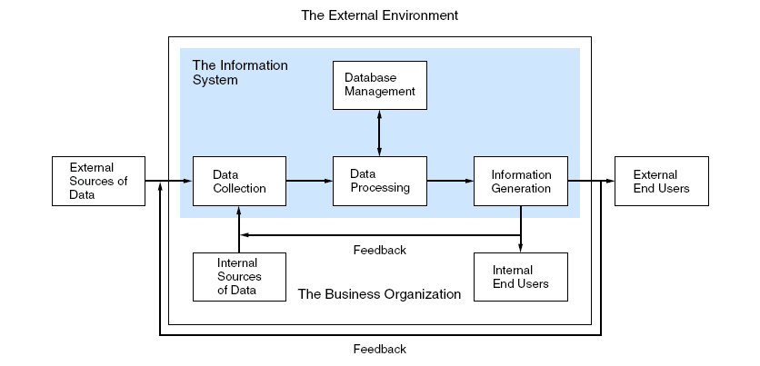
Using the general IS model, explain how fraud can occur at the different stages of information processing?
Notes:
13

Slide 17
Data Collection Fraud
This aspect of the system is the most vulnerable because it is relatively easy to change data as it is being entered into the system.
Also, the GIGO (garbage in, garbage out) principle reminds us that if the input data is inaccurate, processing will result in inaccurate output.
Notes:
23

Slide 18
Data Processing Fraud
Program Frauds
altering programs to allow illegal access to and/or manipulation of data files
destroying programs with a virus
Operations Frauds
misuse of company computer resources, such as using the computer for personal business
Notes:
24

Slide 19
Database Management Fraud
Altering, deleting, corrupting, destroying, or stealing an organization’s data
Oftentimes conducted by disgruntled or ex-employee
Notes:
25

Slide 20
Information Generation Fraud
Stealing, misdirecting, or misusing computer output
Scavenging
searching through the trash cans on the computer center for discarded output (the output should be shredded, but frequently is not)
Notes:
26

Slide 21
Limitations of Internal Controls
Possibility of honest errors
Circumvention via collusion
Management override
Changing conditions--especially in companies with high growth
Notes:
30

Slide 22
Exposures of Weak Internal Controls (Risk)
Destruction of an asset
Theft of an asset
Corruption of information
Disruption of the information system
Notes:
31

Slide 23
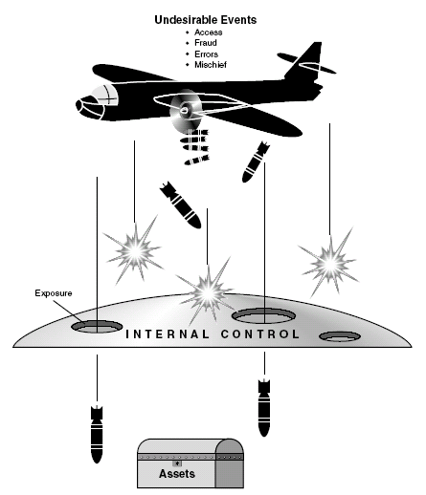
The Internal Controls Shield

Slide 24
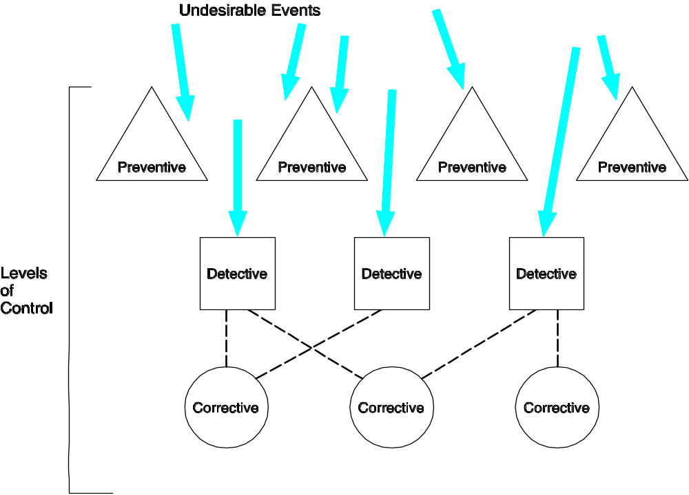
Preventive, Detective, and Corrective Controls

Slide 25
Two Types of IT Controls
General controls—pertain to the entity-wide computer environment
  Examples: controls over the data center, organization databases, systems development, and program maintenance
Application controls—ensure the integrity of specific systems
  Examples: controls over sales order processing, accounts payable, and payroll applications

Slide 26
AUDITING COMPUTER SYSTEMS
Auditing of computerised systems especially where they are distributed may be complex in the following aspects:-
Cost – Auditing of computerised may be expensive especially where CAATs are used.
Data stored in magnetic files may be subject to manipulation without leaving any visible trail.
The auditor may not be able to visit all the company branches because of their location and therefore he may rely on sampling which sometimes may increase his potential liability.
Loss of audit trail, the auditor may not be able to trace totals and balances of individual transactions through the system from source to completion and vice versa, this because some of the intermediary records may be missing.

Slide 27
AUDIT APPROACH IN COMPUTERISED ENV.
Auditing through the computer
This is where the auditor is expected to have the knowledge of inputs, processing and output technology. He studies the equipment, processing and controls incorporated to ensure that all transactions are accounted for. The emphasis of auditing through the computer is to ensure existence and sufficiency of internal control system in processing. The reasons for auditing through the computer are:-
    Loss of audit trail
    There are too many transactions
    There are sophisticated processing program
Advantages
It uses the computer as the auditing tool and hence increase the auditors knowledge of the computer.
There are thorough audit procedures which ensure completeness, accuracy and validity of financial information.
It is the only auditing method which can be used by large organisation.
Faster and easier to use.

Slide 28
Auditing around the computer (black-box auditing)
This is where the auditor is assumed to be computer illiterate. He can only evaluate manual sample and compares it with the computer output. If both are consistent or correct processing is assumed to have been correct also.
Advantages
      There is no need for knowledge on computer technology
      Its the only method used by small companies

Slide 29
AUDIT TRAIL
This is tracing of totals and balances of individual translations through a system from source to completion or vice versa. The need for audit trail is vital for two reasons:-
To identify errors
To detect frauds

Slide 30
COMPUTER ASSITED AUDIT TECHNIQUES (CAATS)
These are techniques which help the auditor to overcome loss of audit trail. They also reduce the chances of errors during auditing and speed up audit examination. CAATs normally come in form of audit packages.

Slide 31
IMPORTANCE OF CAATS
To locate errors and potential fraud by comparing and analysing user criteria.
They can be used to re-calculate and verify balance i.e. as a means of getting audit evidence.
To identify control issues and ensure compliance with standards.
To age and analyse accounts receivables, payables and any other business transactions.
To test for unauthorised employee, or supplier relationships.
To automate repetitive tasks by creating automised application software.
To identify trends and pinpoint exceptions and potential areas of audit trail.
In using CAATs, the auditor may need to consider the risk element, time and the nature of internal control system.

Slide 32
TYPES OF CAATS
a)Use of Test data
This is inputting some data and processing it inorder to test processing data in the way it should be. The auditor may enter sample data and compare the expected results with actual results.

Slide 33
b)Audit interrogation software
This software interrogates all the stages of transactions in a computerised system. He comes up with the programs and uses them to process the data that has been collected by the client. The auditor must take care not to rely too much on this software because it can hinder this creativity.

Slide 34
c)Embedded audit facilities.
This allows a continuous review of the data recorded and treated by the systems. The embedded facility has a monitory system over the enterprises accounting system.

Slide 35
Factors affecting choice of CAATS
Cost
Expertise
Application area
Features available on the CAATs

